Slide 1

How can we, the Body of Christ,
do more for the widows in our community?
The Bible commands us to “plead for the widow”. Too often, the perception is that once a funeral is over and a widow begins to appear to have regained normality in her life no need exists for her care. Nothing can be further from the truth.
The following quotes come from Stand in the Gap widows.
© 2021 Stand in the Gap Ministries

Slide 2


“I will not go to a movie or out to dinner by myself.”
“It is difficult to cook for one.”
“I am at a dinner party for 6 and I’m number 7.”
© 2021 Stand in the Gap Ministries

Slide 3

“Unless you are a widow, you can not understand the depth of this pain.”
“ I would love to have other widow friends to walk along side with through our grief journey.”
© 2021 Stand in the Gap Ministries

Slide 4
“The cards, the calls, the visits all stopped after a few months. No one said it to my face, but they had moved on with their lives.”
“The most loving thing you can do for me is to remember my husband and share your memories of him.”
The worst days of my year are:
My husband’s Heavenly Birthday
Our Anniversary
Valentine’s Day
Christmas
© 2021 Stand in the Gap Ministries

Slide 5

“I often feel taken advantage of when I get repairs done on my home or car.”
“I am scared to climb a ladder to change a lightbulb or clean the gutters. It is not safe to do these type of projects when I live alone.”
© 2021 Stand in the Gap Ministries

Slide 6
WHY A WIDOW MINISTRY?
Many widows feel like they are in a “fog” after their husband’s death. They often lose friendships, experience financial hardship, or struggle with illness themselves. The realities of life as a widow usually bring their own, fresh grief.
But being a widow does not have to mean being alone.
We can help by hosting social gatherings, providing practical home
and car care maintenance, a freezer meal ministry, or facilitating
small groups of widows.
Join Us & Stand in the Gap for Widows.
© 2021 Stand in the Gap Ministries

Slide 7

Stand in the Gap for Widows research suggests that widows need:
Social interactions with other widows.
Small Groups of widows to walk their grief journey.
Practical Help with freezer meals, home maintenance and car care needs.
To be remembered and ministered to through a Card & Book Ministry.
© 2021 Stand in the Gap Ministries

Slide 8

Many widows feel alone and that no one understands.
Having a strong network of support and a community bond fosters both emotional and physical health.
A social ministry can consist of special dinners designed specifically for widows, group projects, frozen meal parties or events.
“I’m at a dinner party for 6 and I’m number 7.” - Widow Voice
“I was overwhelmed and tears filled my eyes when I walked into the room and realized the time and effort that went into this event and just for us.” - Widow Voice
© 2021 Stand in the Gap Ministries

Slide 9

Widows need someone to help them sort through their emotions and in the process, someone who will cry with them, allow them to express fully their pain and struggles and who will be there for them as they face the crises that inevitably come.
Our research shows that widows are hurting deeply one year, two years and even ten years plus. In a SITGM small group there is no directing, counseling, steering toward a predetermined goal, no manipulation, no fixing — just a complete reliance on God to work.
“I was with my husband when he died suddenly. After 42 years of marriage, half of me was gone.” - Widow Voice
“No one can comfort a widow like another widow. When we see another woman enter this experience…we want to comfort her.” - Miriam Neff
© 2021 Stand in the Gap Ministries

Slide 10

Repeatedly, widows have told SITGM they need practical help. Our widow programs provide for their needs through our freezer meals, home maintenance and car care ministries.
Widows often find it hard to cook for one person and find themselves eating out and not getting the nutrition they may need. The desire for homemade food spurred the formation of a freezer meal ministry. It is practical, kind, and meets a large need.
Widows need information and assistance on issues concerning their home and car maintenance, they need help finding quality products and qualified service providers, and they need advice and guidance from a trusted and knowledgeable church family member.
© 2021 Stand in the Gap Ministries

Slide 11

A Car Care Ministry is designed to help the widowed women of your church and community with basic car care needs such as: washing, vacuuming, oil checks, fluid checks, belts and hose inspection, tire pressure and checking the car for any needed repairs. The widow can receive free, proper care and valuable advice concerning her car’s condition.
“The car care clinic made me feel more empowered to deal with my car and its repair and maintenance. I trust them to give me honest advice.” - Widow Voice
“I always feel ignorant when I go to a garage and feel they could easily take advantage of me. Now I can feel safe that my car will be taken car of and I will receive honest advice.”
- Widow Voice
© 2021 Stand in the Gap Ministries

Slide 12

One of our practical needs ministries is a Home Maintenance Ministry called Widow Saturday. It is constructed to help widows with minor repair projects around the house.
Widows tell us they often feel vulnerable when it comes to getting work done on their homes. Having a trusted church volunteer provide helpful advice and repair work means a great deal to widows.
“When my husband was alive, we divided our responsibilities and he took care of maintaining the house. If something goes wrong, I don’t even know where to turn off the water.” - Widow Voice
© 2021 Stand in the Gap Ministries

Slide 13

The ministry purpose is to covey the light and love found in Jesus Christ through correspondence.
Remembering a widow on her birthday, Valentine’s Day, Christmas, Thanksgiving, the day her husband went home, etc., will express our love and show we have not forgotten them.
“The cards, the calls, the visits, they all stopped. No one told me to my face but they had all moved on with their lives.” Widow Voice
“The most loving thing you can do for me is to tell me you remember my husband.” - Widow Voice
© 2021 Stand in the Gap Ministries

Slide 14

Thoughts
Questions

Slide 15
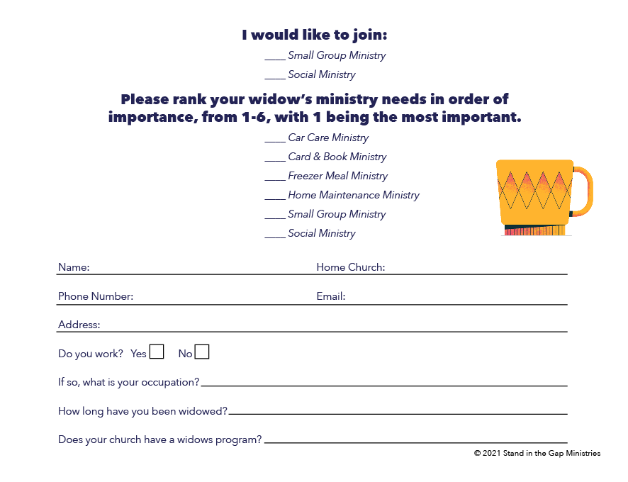

Slide 18
Religion that God our Father finds pure and faultless, is this: take care of HIS widows. James 1:27
Stand in the Gap for Widows
© 2021 Stand in the Gap Ministries

