Slide 1
COFFEE, CAKE, & CONVERSATION
Stand in the Gap For Widows Program Event
© 2025 Stand in the Gap Ministries

Slide 2
Learn something new about someone at your table!
© 2025 Stand in the Gap Ministries

Slide 3
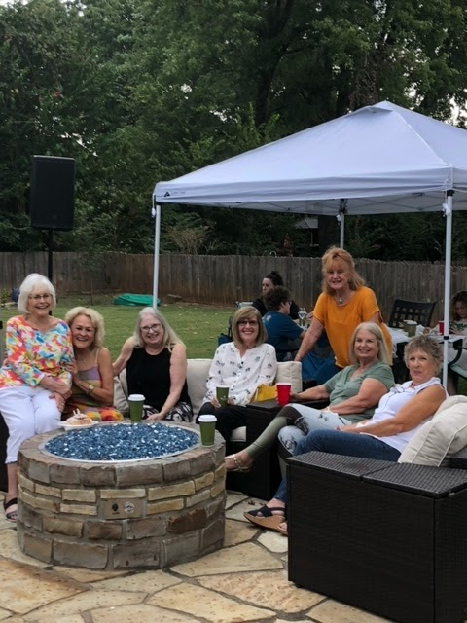
How can we, the Body of Christ, do more for the widows in our community?
The Bible commands us to “plead for the widow”. Too often, the perception is that once a funeral is over and a widow appears to have regained normality in her life, no need exists for her care. Nothing can be further from the truth.
© 2025 Stand in the Gap Ministries

Slide 4
“The most loving thing you can do for me is to remember my husband and share your memories of him.”
The following quotes come from Stand in the Gap Widows.
“Unless you are a widow, you can not understand the depth of this pain.”
“It is difficult to cook for one.”
“I will not go to a movie or out to dinner by myself.”
“The cards, the calls, the visits all stopped after a few months. No one said it to my face, but they had moved on with their lives.”
“The worst days of
my year are:”
My husband’s
Heavenly Birthday
Our Anniversary
Valentine’s Day
Christmas
“I would love to have other widow friends to walk along side with through our grief journey.”
© 2025 Stand in the Gap Ministries

Slide 5
WHY A WIDOW MINISTRY
The Bible implores us!
* Your church cares
*You are seen
*You are loved
Many widows feel like they are in a “fog” after their husband’s death. They often lose friendships, experience financial hardships and struggle with the tasks that were done by their husbands. The realities of life as a widow can be a daily reminder of the loss and bring long-term struggles.
Being a widow does not have to mean being alone. You can find community and support from your church and other widows on a similar journey.
Your church and volunteers can help by hosting social gatherings, providing home and car care maintenance, a freezer meal ministry, or facilitating small groups for widows.
© 2021 Stand in the Gap Ministries
© 2025 Stand in the Gap Ministries

Slide 6
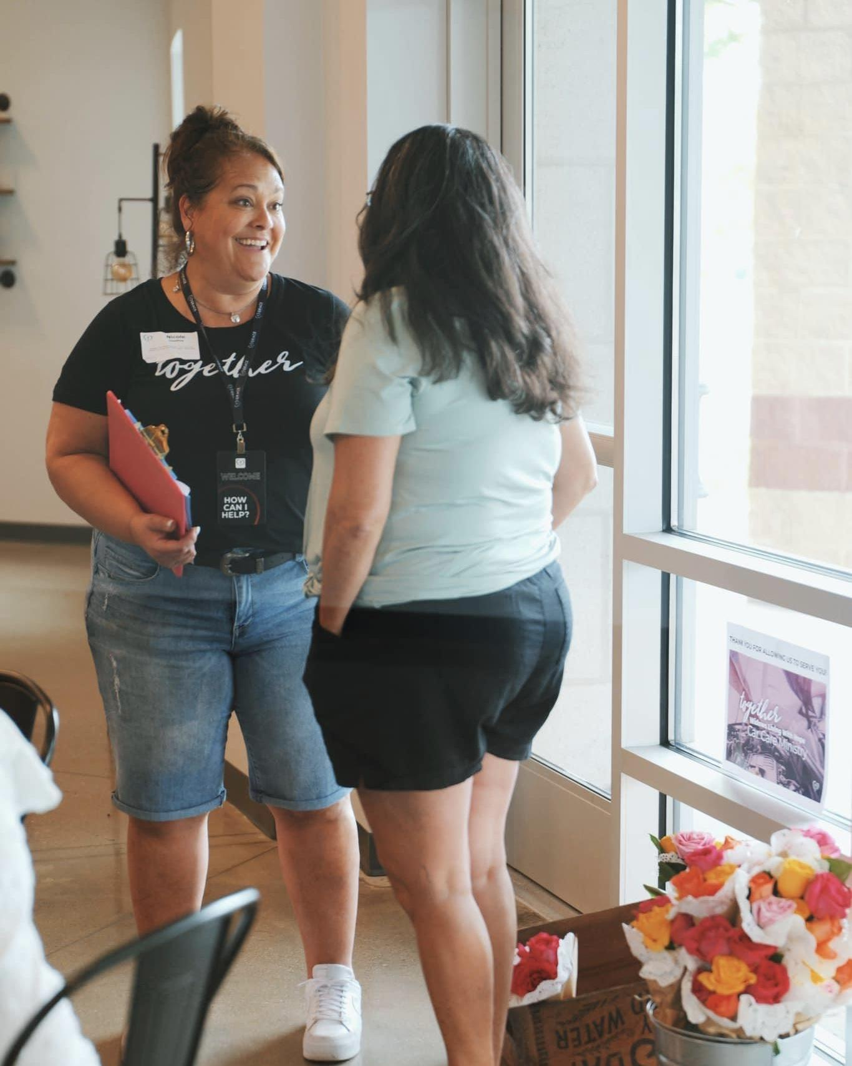
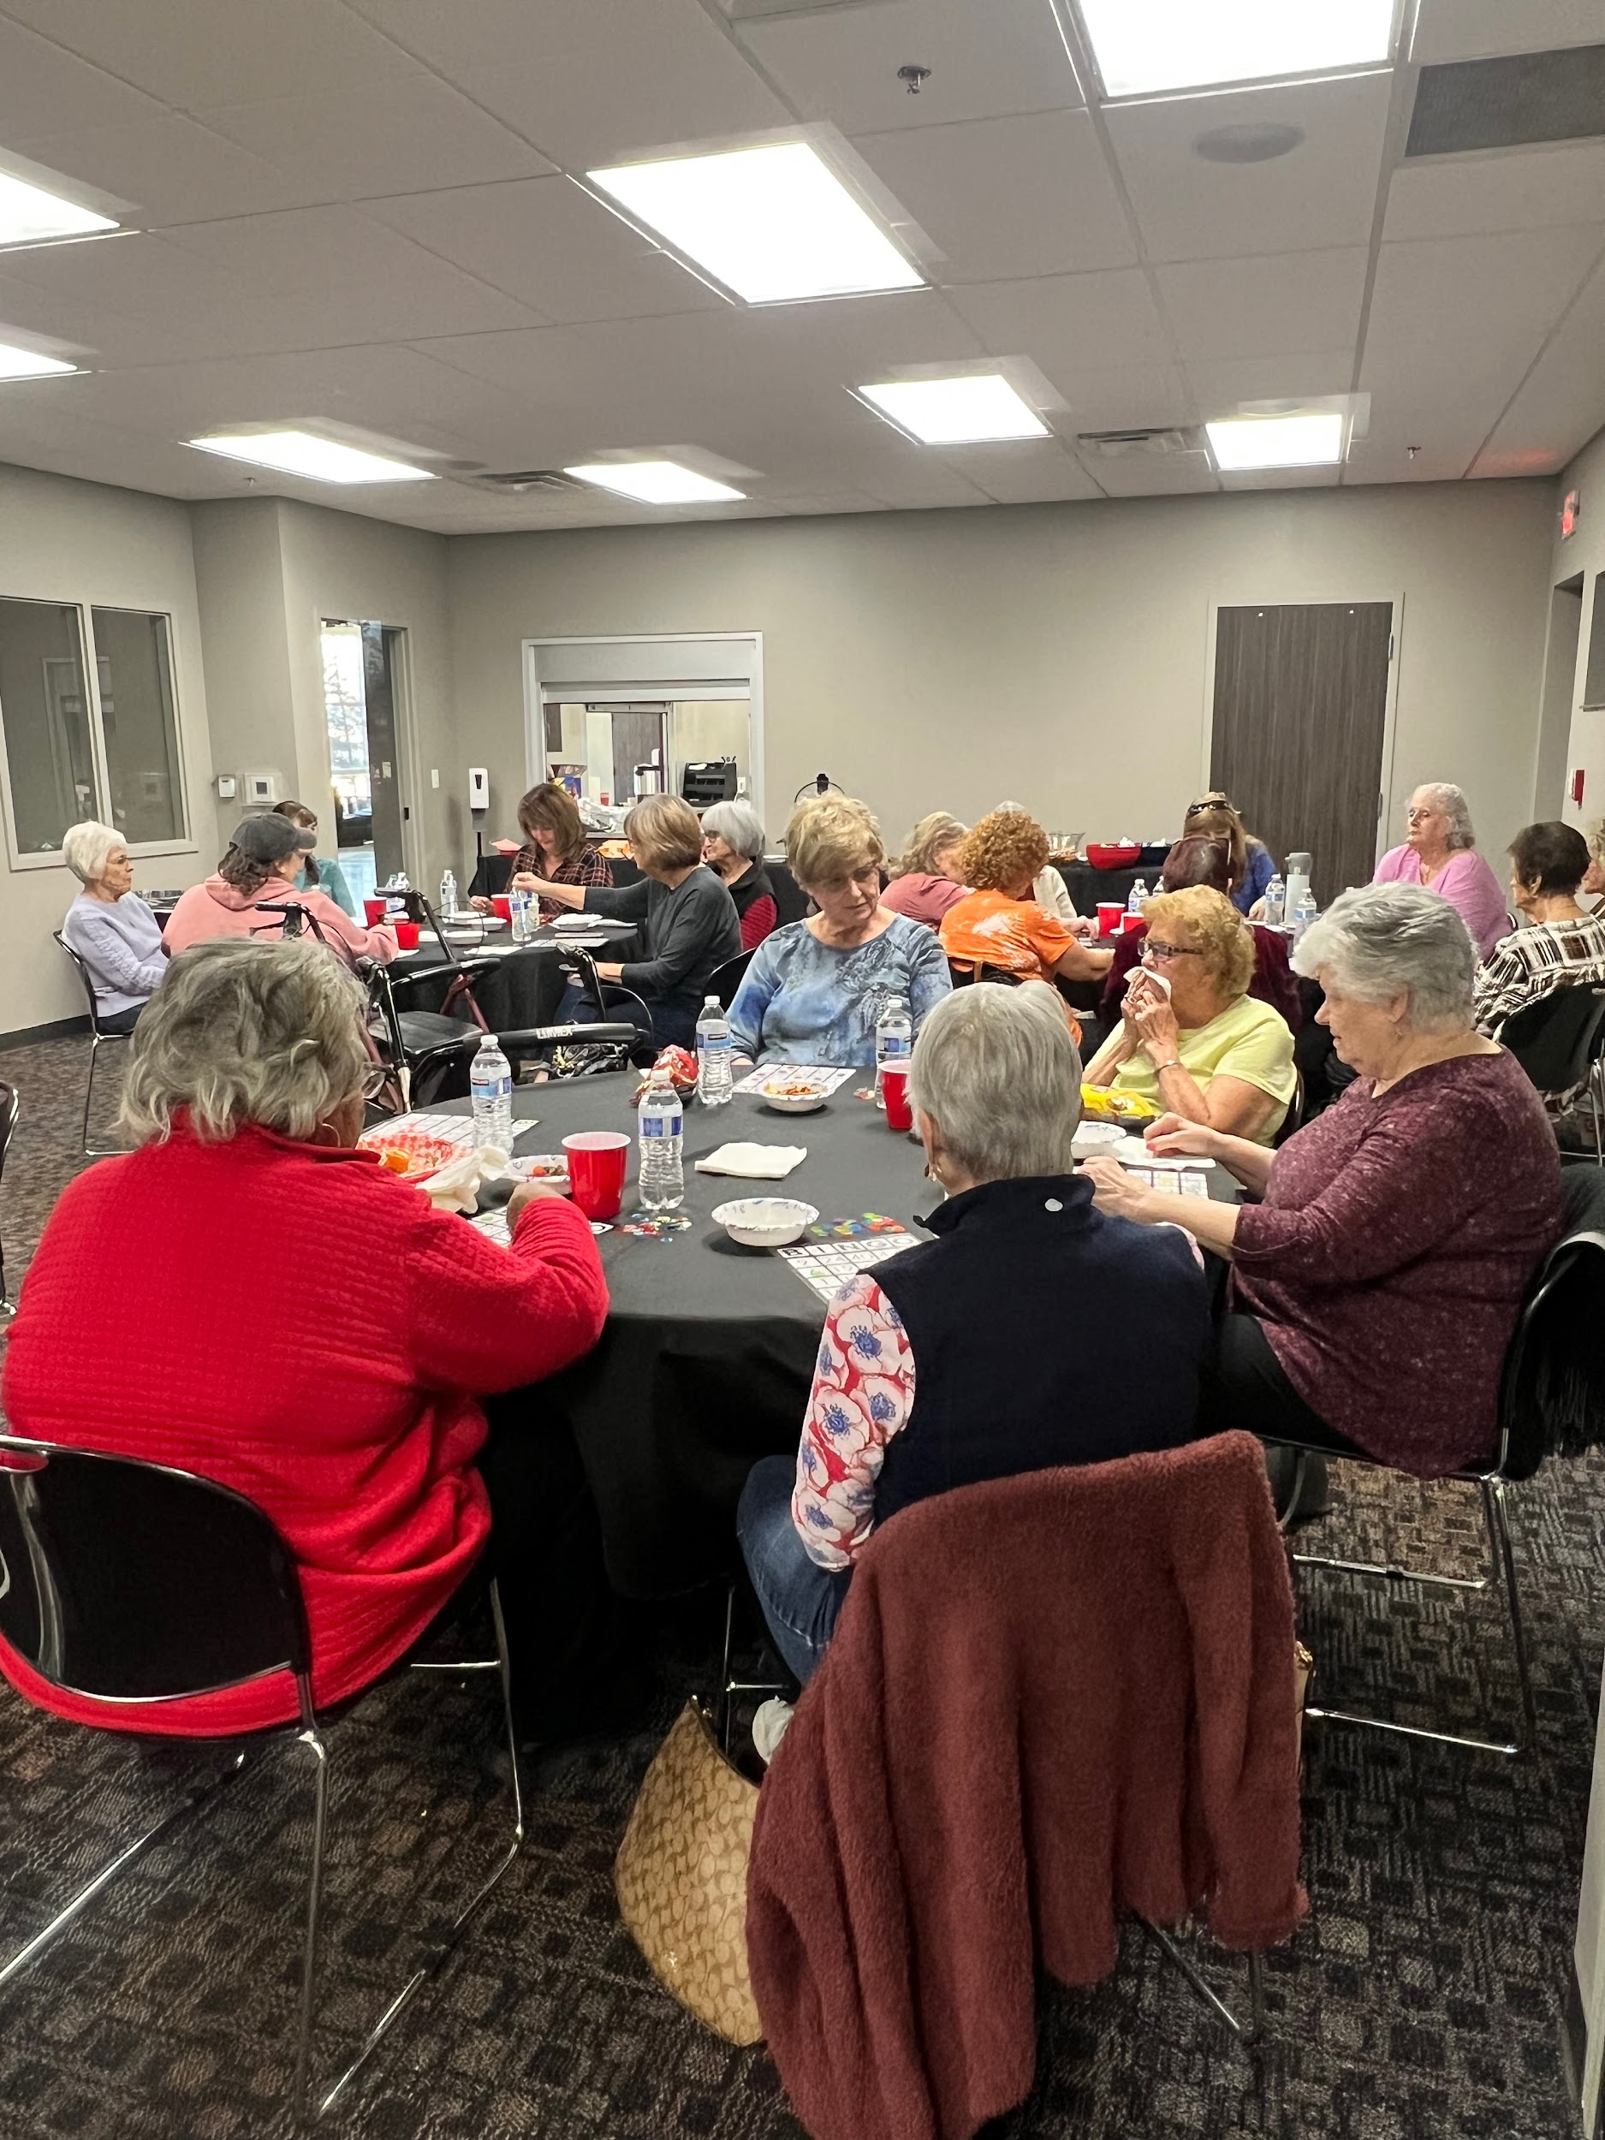
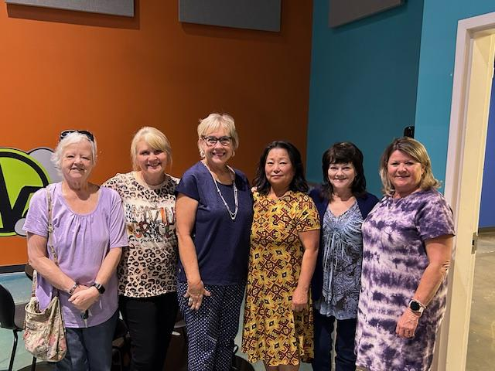
Stand in the Gap for Widows research suggests that widows may have the following needs:
Social interactions with other widows.
Small Groups of widows to walk their grief journey.
Practical Help with freezer meals, home maintenance and car care needs.
To be remembered and ministered to through a Card & Book Ministry.
1st Year Ministry - Caring for widows in the 1st year after a loss.
1st Response - A team that cares for widows from the 1st day.
Widows Retreat - A way to create deeper community.
**Note: not all will be done immediately.
We want to know what you need!**
© 2025 Stand in the Gap Ministries

Slide 7
Social
Ministry
Many widows feel alone and that no one understands. These events provide a time for community and meeting others that understand.
Having a strong network of support and a community bond fosters both emotional and physical health.
A social ministry can consist of special dinners designed specifically for widows, group projects, frozen meal parties or events.
Every church does the social ministry a bit differently, but each time is an important opportunity to build community.
If you are a volunteer, this is a great way to get involved!
© 2025 Stand in the Gap Ministries

Slide 8
Small Groups
Small groups allows widows a place to process through emotions with others who understand.
These groups are not simply a time of crying (though tears will come sometimes), but most importantly they are a time to build community and provide an opportunity for spiritual growth.
Stand In The Gap Ministries has also created a small group curriculum that was written for widows by widows. It is designed for widows at many different stages in their journey.
Many churches start with Small Groups and then move forward into the other areas of the ministry.
© 2021 Stand in the Gap Ministries
© 2025 Stand in the Gap Ministries

Slide 9
Practical
Needs
1st Year Ministry – A way to learn how to care for widows for the 1st year after loss. Providing people who support, provide information and plug widows into a community, allowing them to have the support and love they need in the hard 1st year. This ministry also allows other ministries in your church to get involved to care for these new widows in practical and emotional ways.
1st Response – A way to care for widows starting on the 1st day after the loss. This team cares for the widow, shows up, and may become a part of the 1st year care. This team is also a way that other widows may want to volunteer and support other widows right after loss.
© 2025 Stand in the Gap Ministries

Slide 10
Practical
Needs
Practical needs are an area that we have heard again and again widows need support in. From help with taking care of their car to home projects to freezer meals, Stand In The Gap Ministries recommends many different practical needs to help support your widow's ministry.
Widows often find it hard to cook for one person and find themselves eating out and not getting the nutrition they may need. The desire for homemade food spurred the formation of a freezer meal ministry. It is practical, kind, and meets a large need.
Widows need information and assistance on issues concerning their home and car maintenance, they often need help finding quality products and qualified service providers, and they need advice and guidance from a trusted and knowledgeable church family member.
© 2025 Stand in the Gap Ministries

Slide 11
Home Maintenance
Car Care
One of our practical needs ministries is a Home Maintenance Ministry. It is constructed to help widows with minor repair projects around the house.
Widows tell us they often feel vulnerable when it comes to getting work done in their homes. Having a trusted church volunteer provide helpful advice and repair work means a great deal to widows.
Some of these tasks can be small and easy to do, but the impact made is immeasurable!
A Car Care Ministry is designed to help the widowed women of your church and community with basic car care needs such as: washing, vacuuming, oil checks, fluid checks, belts and hose inspection, tire pressure and checking the car for any needed repairs.
The widow can receive free, proper care and valuable advice concerning her car’s condition.
This ministry can be a huge benefit to the widows in your church and community.
© 2021 Stand in the Gap Ministries
© 2025 Stand in the Gap Ministries

Slide 12
Widows Retreat
A retreat is a way to provide a place of community & connection and allow widows to grow closer to God during a special weekend with other widows. This may be something special that is done for widows when a ministry is starting out or for well-established widows groups.
© 2021 Stand in the Gap Ministries
© 2025 Stand in the Gap Ministries

Slide 13

Card
&
Book
This ministry is a simple, but impactful ministry for widows.
Remembering a widow on her birthday, Valentine’s Day, Christmas, Thanksgiving, the day of her husband’s heavenly birthday, etc., will express love and show we have not forgotten them.
There is also a book series that can be helpful for new widows in your church and community as they walk through the first year.
© 2025 Stand in the Gap Ministries

Slide 14
thoughts…
questions?
© 2025 Stand in the Gap Ministries

Slide 15
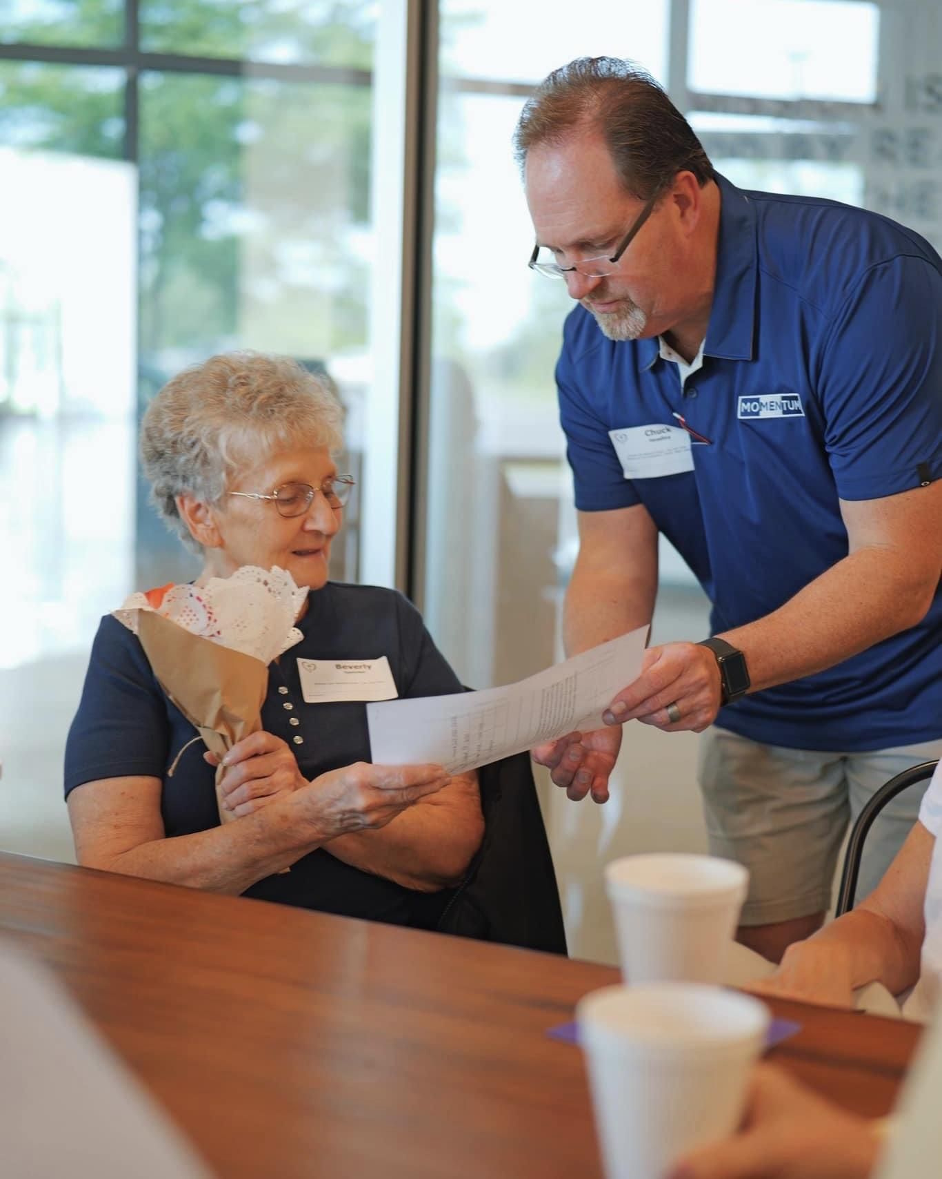
Call to Action:
What now?
Fill out:
Remember you are seen
Remember you are loved
Your church cares!
Your widow or volunteer response forms on your table (we will go over them on the next page)
If you are a volunteer, pray about getting involved.
© 2025 Stand in the Gap Ministries

Slide 16
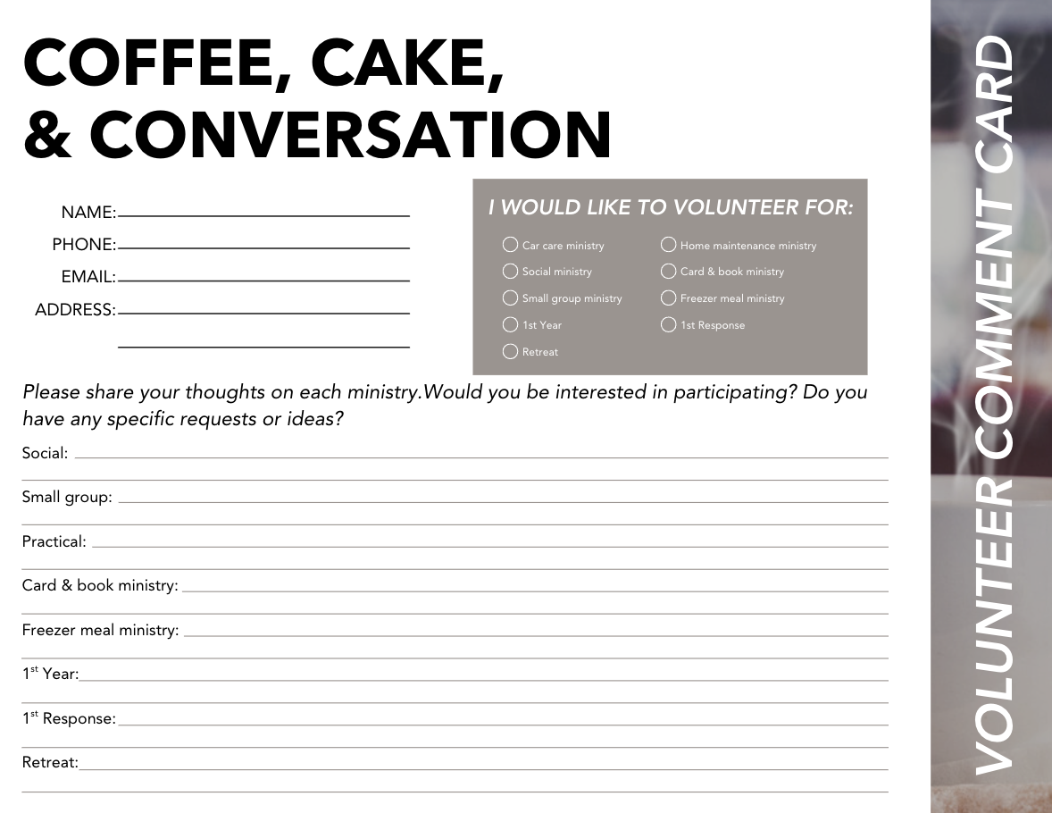
© 2025 Stand in the Gap Ministries

Slide 17
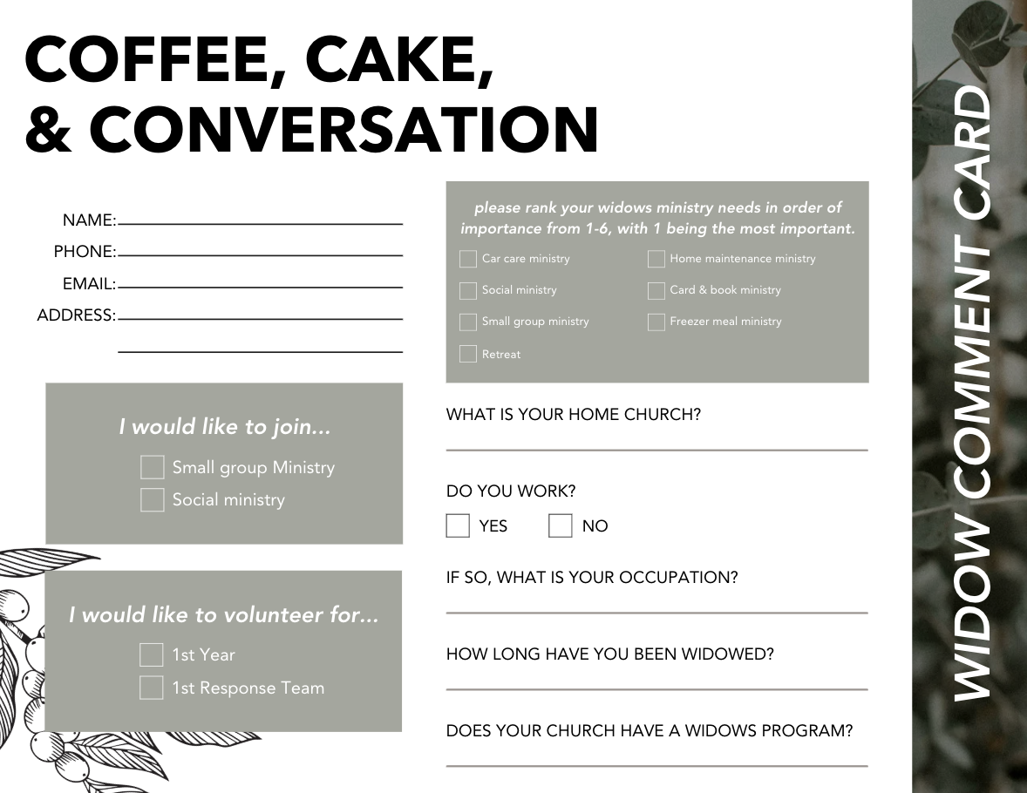
© 2025 Stand in the Gap Ministries

Slide 18
Final Reminders:
Please Remember:
Fill out form(s)
Pray for the ministry
Your church will be reaching out to get you plugged in as a widow or volunteer
“Religion that God our Father finds pure and faultless, is this: take care of HIS widows.”
James 1:27
© 2025 Stand in the Gap Ministries

